Slide 1
ICSE Academy
Cluster 4
SESSION 3
Innovative assessment practices and Equity in STEM classrooms: Assessing students with diverse learning needs
Notes:
Maria

Slide 2
Structure of the session
PART Α (70 min)
  Τhe focus will be specified on equity and assessment in STEM disciplines. Three chat activities (50 min)
  Group activity 1 (20 min)
PART Β (20 min)
  Group activity 2
    Working on Cluster 4, session 3 homework assignment (10 min)
    Presenting your ideas (10 min)

Slide 3
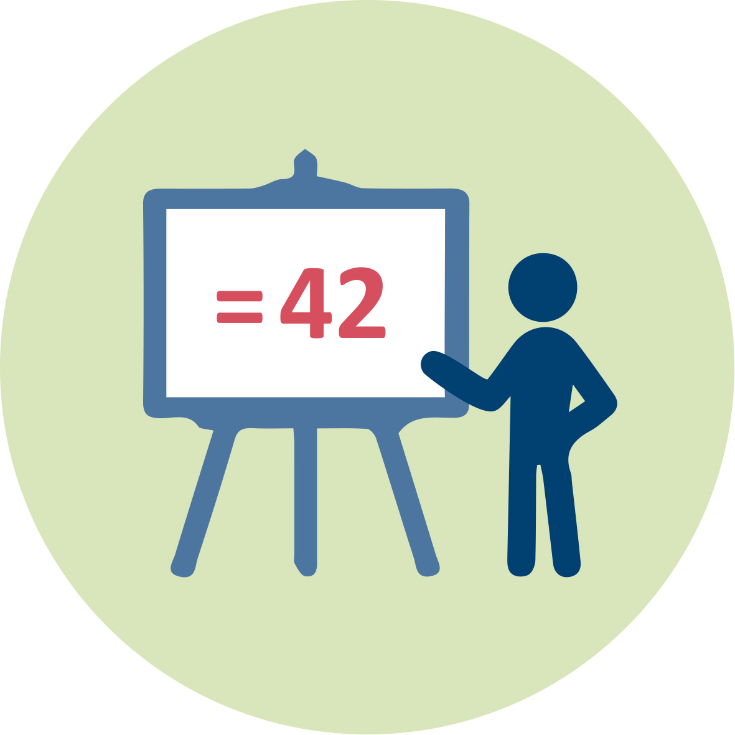




Session activities
Plenary presentations
Whole class discussions/chat activities
  To participate in these discussions
    you can either writing on the WEBEX- CHAT or raising your WEBEX-HAND
Group work activity
  Share your ideas in the group and report them in a google doc
  You are all kindly invited to contribute in these discussions and share your ideas and concerns

Slide 4
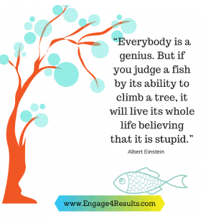
Equity and assessment
«While there are multiple ways for students to learn, students need to demonstrate learning in specific ways for it to count.»
“An assessment process that is not mindful of equity can risk becoming a tool that promotes inequities, intentionally or not.”
Montenegro & Jankowski, 2020, p. 6.
https://www.google.com/search?q=Everybody%27s+a+Genius+but+If+You+Judge+a+Fish+By+Its+Ability+to+Climb+a+Tree%2C+It+Will+Live+Its+Whole+Life+Believing+It+Is+Stupid&rlz=1C1GCEA_enGR947GR947&oq=Everybody%27s+a+Genius+++but+If+You+Judge+a+Fish+By+Its+Ability+to+Climb+a+Tree%2C+It+Will+Live+Its+Whole+Life+Believing+It+Is+Stupid&gs_lcrp=EgZjaHJvbWUyBggAEEUYOdIBCTMxNjZqMGoxNagCALACAA&sourceid=chrome&ie=UTF-8#vhid=Ae-3Rzp3iFkFhM&vssid=l

Slide 5
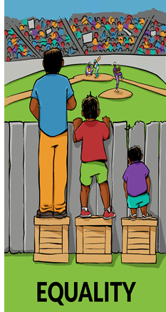
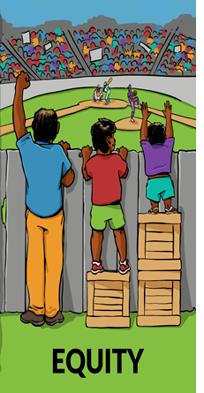
If the field of the game represents the ‘classroom learning activities’, what do these figures show?
Chat activity

Slide 6
Equity
Equity addresses ways to remove barriers to participation in STEM disciplines and increase students’ achievement

Slide 7
Assessment strategies that support equity issues

Slide 8
Str 1: Promoting equity through formative assessment (Assessment for Learning/AfL)
Formative assessment can open more opportunities to promote equity for learners with diverse needs and experiences.
Some key actions are…
    Providing effective questioning and feedback by
      setting precise and direct questions;
      taking into consideration students’ socio-emotional needs (e.g., affirmative feedback)
    Activating students as instructional resources for one another (e.g., use peer assessment methods).
    Activating students as the owners of their own learning (e.g., use self assessment methods).
    Andersson, C. (2020).

Slide 9
Str 2: “The Rights of the learners’ framework”
Developing an inclusive classroom culture
The learner in the classroom
(1) has the right to be confused;
(2) has the right to claim ‘not understanding’;
(3) has the right to speak, listen and be heard; (e.g., to contribute in classroom discussions; to ask Questions/share Ideas)
(4) has the right to write, do (model with gestures and manipulate with tools); and represent only what makes sense to her/him.
Kalinec-Graig, 2017

Slide 10
Str 3: Keeping ‘Learners’ profile Diaries’ to describe the ways a student learns best
A ‘learners’ profile diary’could include information on students’ ...
  interests (e.g., reading, listening to music, playing sports)
  learning styles (e.g., Analytic that involves the linear type of learning found most often in schools; Practical that involves seeing how and why things work as people actually use them; Creative that involves making new connections and seeking innovation)
  Differences based on their gender/culture/personality (e.g., being expressive or reserved in class interactions; preferring competition or collaboration; preferring to work individually or in a group)
  learning strengths and weaknesses
  A learner profile needs to be dynamic, as individual learners are constantly growing and changing.
    Thomas, et al., 2023; Tolminson et al., 2003

Slide 11
Which one of the presented strategies is closer to your interest as a STEM teacher?
Chat activity
Str 1: Promoting equity through formative assessment (AfL);
Str 2: “The Rights of the learners’ framework”
Developing an inclusive classroom culture
Str 3: Keeping “Learners’ profile Diaries”

Slide 12
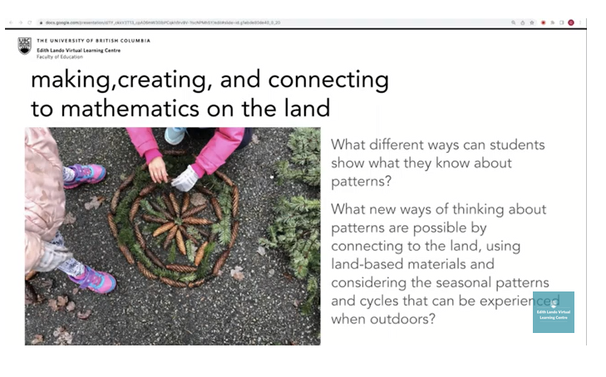
Video- clip on “What we can learn from the land about patterns?” https://www.youtube.com/watch?v=9Uf7_1NevGI&t=3079s
49:50 - 52:46
This video-clip presents how the land-based materials can offer us ideas on teaching and assessing students about patterns/repetitions in elementary mathematics.
After watching this video clip you will be asked to adopt the idea presented in the video-clip while enacting the Air-quality problem in a STEM classroom.

Slide 13
Group activity 1 (20 min)
“What can the land/environment offer us in STEM education?”
Watch the video-clip and answer in the Google doc the following questions:
a) How can you adopt the idea presented in the video-clip while enacting the Air-quality problem in your classroom?
b) How could this idea advance inclusion and equity?
c) Choose one STEM competence and suggest one learning outcome while assessing this idea in your classroom.
List of STEM competences: Communicating and presenting ideas and argumentation skills; problem solving and modelling; use of representations; working technically; applying scientific knowledge in response to perceived human wants or needs; understanding the changes caused by human activity and developing responsibility as an individual citizen; other…
List of learning outcomes for assessing students’ learning: Generates, discusses, and chooses interesting questions to investigate/justifie the most appropriate way to investigate; Uses scientific ideas to make testable predictions; Suggests more than one way to investigate the question; Identifies the variables in the investigation and explains the predicted relationships between the variables; other…

Slide 14
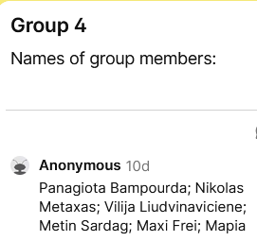
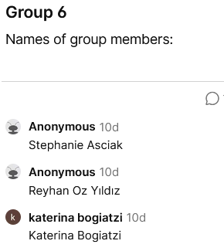
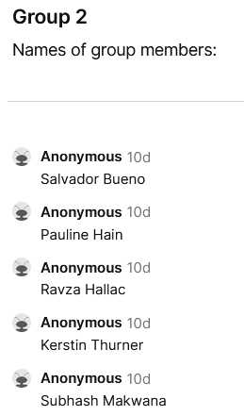
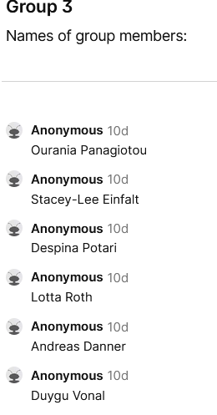
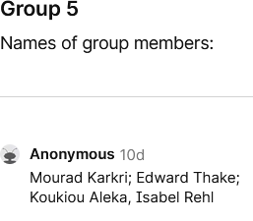
Members of Group 1-6 (from Cluster 4, session 1)
Please, the members of each group (who are participants and not TEs) find ways to communicate and work together.
Group 1: David, Maria Teresa, Laura, Betul, Ulrika, Giorgos

Slide 15
Special cases
Chat activity
Who could be excluded?

Slide 16
Special case I: Students with different cultural background
  ‘Culturally responsive assessment’
    Culture refers to explicit elements that makes people identifiable as a specific group(s) including background; language; religion; heritage, race/ethnicity etc.
    Responsive means an action-based, urgent need to create contexts and curriculum that responds to the social, political, cultural, and educational needs of students
    (Khalifa, Gooden, & Davis, 2016).

Slide 17
Strategies for Culturally responsive assessment
  Provide assessment designs that are contextualized and relevant to learners’ lives/interests/funds of knowledge (e.g., the air quality in their own town/neighborhood)
  Use appropriate student-focused and cultural language in learning statements to ensure students understand what is expected of them (e.g., translate main notions in their own language or allow them to use a dictionary).

Slide 18
Special cases II:
Students with learning disabilities
      Mild learning disabilities (e.g., dyslexia) or severe learning disabilities (e.g., physical, sensory or cognitive)
      Recommending assessment accommodations for students with learning disabilities
    Assessment accommodations
        Changes/modifications made to an assessment procedure

Slide 19
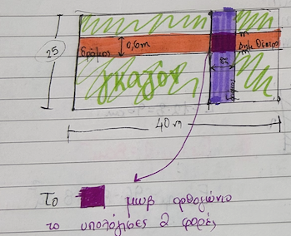
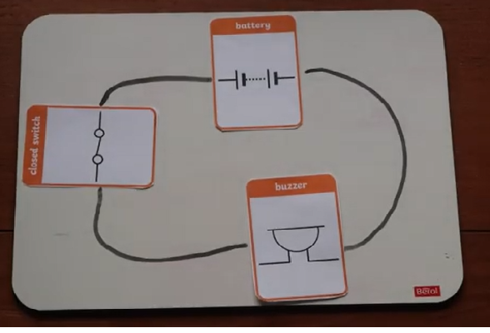
Assessment accommodations for students with learning disabilities
Accommodations are generally grouped into the following categories:
Task presentation (e.g., repeat directions, read aloud, use of larger bubbles on answer sheets or use of visual tools such as color-coding)
• Use of reference materials such as cue cards (designed in such a way to help someone to remember what to say by giving her a 'cue' or prompt) or use of strategy steps (step1 ….; step 2… etc.)
• Timing/Scheduling (e.g., extended time, frequent breaks)
• Setting (e.g., special lighting, separate room)
Color-coding is the use of colors to represent data values on a task.
Cortiella, C. (2005)

Slide 20
Summing up: How do I ensure my assessments are equitable for all students?
Use multiple assessment methods/tools
Provide reasonable accommodations
Use clear language that is understood by all
Be specific and transparent about what you are expecting of them.
counter any implicit biaseshttps://cei.umn.edu/teaching-resources/assessments/equitable-assessments when creating and grading assessments

Slide 21
PART B (10 mins)
Cluster 4 Session 3
Homework assignment- Group Activity 2
For a specific age group respond to the following question:
How would you assess pupils’ learning while working on the Air Quality problem in equitable ways?
  Refer to possible adaptations in your assessment designs for only one of the special cases presented before i.e. either students with different cultural backgrounds or students with learning disabilities.
    Hinds: You may suggest modifying some of the STEM competences or the learning outcomes or the assessment tools that you will use; You might incorporate ideas presented on Cluster 2, session 3 on diversity (slides 17, 18) as well as on Cluster 4, sessions 1 and 2.

Slide 22
Each group’s deliverable
Design a poster (or ppt) where you report on the tasks (homework assignments) presented in Sessions 1, 2 and 3.
Deadline: June 18
Please, the members of each group (who are participants and not TEs) find ways to communicate and work together. THIS IS A GROUP ACTIVITY!
Questions for clarification

Slide 23
Selected References
Andersson, C. (2020). Formative assessment – from the view of special education teachers in mathematics. Nordic Studies in Mathematics Education,25 (3-4), 73–93.
Cortiella, C. (2005). No Child Left Behind: Determining Appropriate Assessment Accommodations for Students with Disabilities. National Center for Learning Disabilities.
Harris, C. J., Wiebe, E., Grover, S., & Pellegrino, J. W. (2023). Classroom-Based STEM Assessment: Contemporary Issues and Perspectives. Community for Advancing Discovery Research in Education (CADRE).
Heritage, M., & Wylie, C. (2018). Reaping the benefits of assessment for learning: Achievement, identity, and equity. ZDM, 50(4), 729-741
Kalinec-Craig, C. A. (2017). The rights of the learner: A framework for promoting equity through formative assessment in mathematics education. Democracy and Education, 25(2), 5.
Montenegro, E., & Jankowski, N. A. (2020). A new decade for assessment: Embedding equity into assessment praxis (Occasional Paper No. 42). Urbana, IL: University of Illinois and Indiana University, National Institute for Learning Outcomes Assessment (NILOA).
Nortvedt, G. A., & Buchholtz, N. (2018). Assessment in mathematics education: Responding to issues regarding methodology, policy, and equity. ZDM, 50(4), 555-570.
Thomas, R. K., Strekalova-Hughes, E., Nash, K. T., Holley, M., Warner, C. K., Enochs, B., ... & Ricklefs, M. (2023). The learner profile: piloting a tool to support contextualized understanding of the learner. Journal of Early Childhood Teacher Education, 44(3), 349-372.
LINK
https://elvlc.educ.ubc.ca/culturally-responsive-mathematics-assessment/

